Slide 1
Computer Graphics 8:
Projections

Slide 2
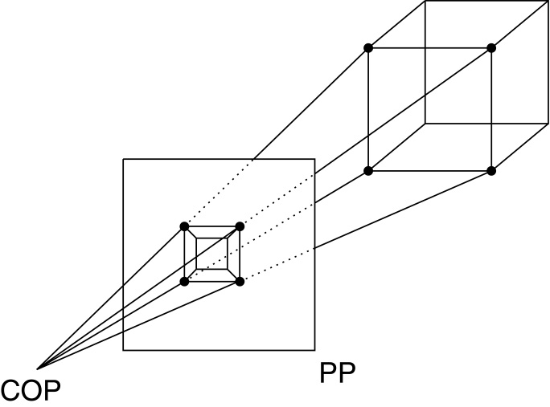
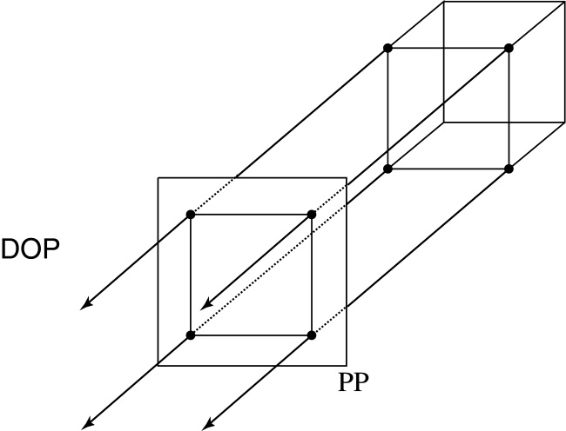
Projections
Projections transform points in n-space to m-space, where m<n.
In 3-D, we map points from 3-space to the projection plane (PP) (image plane) along projectors (viewing rays) emanating from the center of projection (COP):
There are two basic types of projections:
  Perspective – distance from COP to PP finite
  Parallel – distance from COP to PP infinite

Slide 3
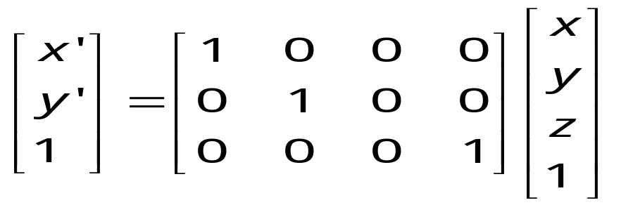
Parallel projections
For parallel projections, we specify a direction of projection (DOP) instead of a COP.
We can write orthographic projection onto the z=0 plane with a simple matrix, such that x’=x, y’=y.
Notes:
Drop z value

Slide 4
Parallel projections
For parallel projections, we specify a direction of projection (DOP) instead of a COP.
We can write orthographic projection onto the z=0 plane with a simple matrix, such that x’=x, y’=y.
Normally, we do not drop the z value right away. Why not?
Notes:
Drop z value
You may wonder, why bother to introduce so many zeros to have a matrix. You will see later the unification reason later.

Slide 5
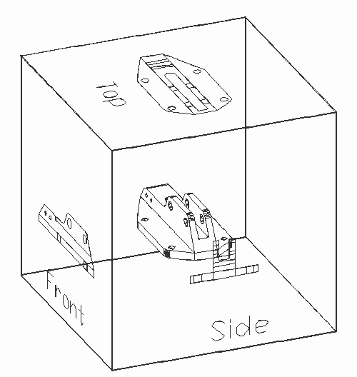
Properties of parallel projection
Properties of parallel projection:
  Are actually a kind of affine transformation
    Parallel lines remain parallel
    Ratios are preserved
    Angles not (in general) preserved
  Not realistic looking
  Good for exact measurements,
  Most often used in
    CAD,
    architectural drawings,
    etc.,
  where taking exact measurement
  is important
Notes:
Scanalyze

Slide 6
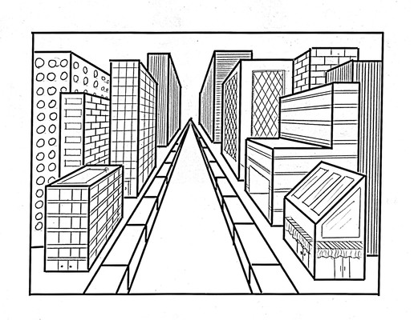

Perspective effect
Notes:
Distant objects are smaller
Paralle lines meet

Slide 7
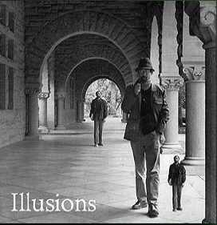
Perspective Illusion

Slide 8
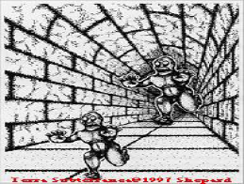
Perspective Illusion

Slide 9
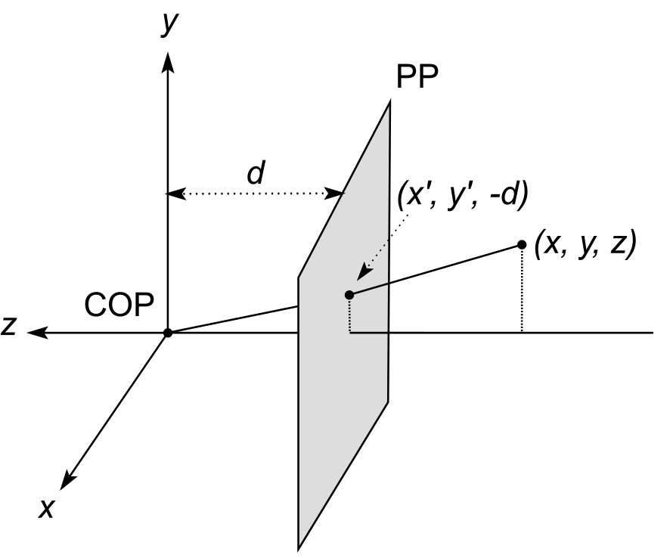
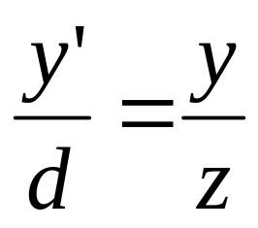
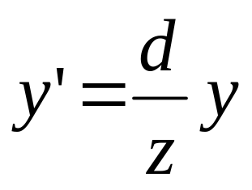
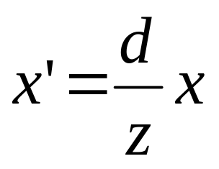
Derivation of perspective projection
Consider the projection of a point onto the projection plane:
By similar triangles, we can compute how much the x and y coordinates are scaled:
Notes:
y/z = y’/-d
y’ = -y/z d
x’ = -x/z d
Distant things look smaller

Slide 10

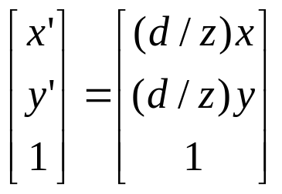
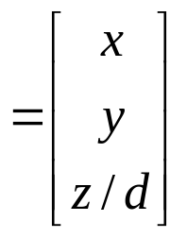
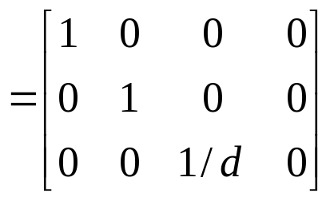
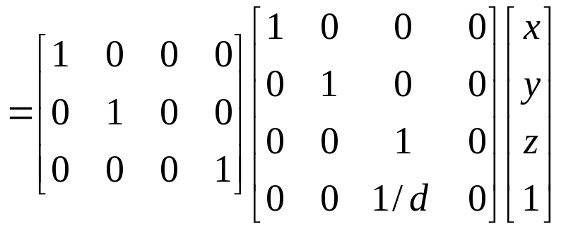
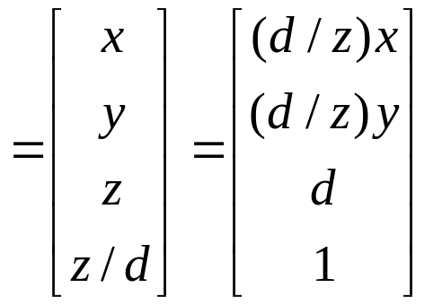
Homogeneous coordinates and perspective projection
Now we can re-write the perspective projection as a matrix equation:
Orthographic projection
Notes:
x/z const, map to the same point
What’s important here is that we can represent nonlinear thing using homo coord
Only last row is different
(4,4) is no longer zero
Decompose complex tasks into simpler ones.
Lost z is not best choice.

Slide 11
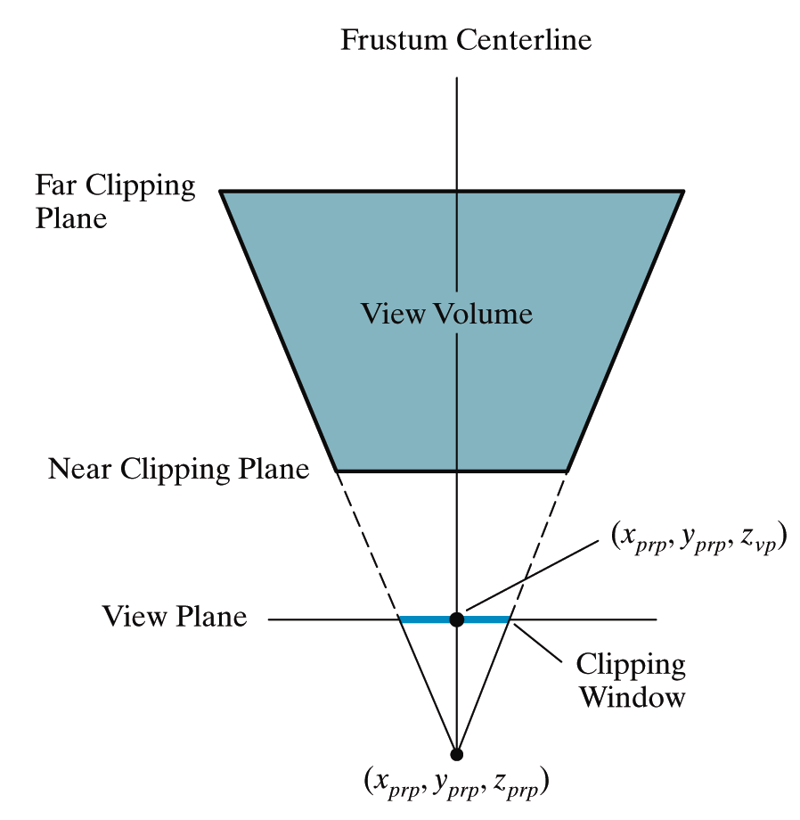
Setting Up A Perspective Projection
A perspective projection can be set up by specifying the position and size of the view plane and the position of the projection reference point

Slide 12
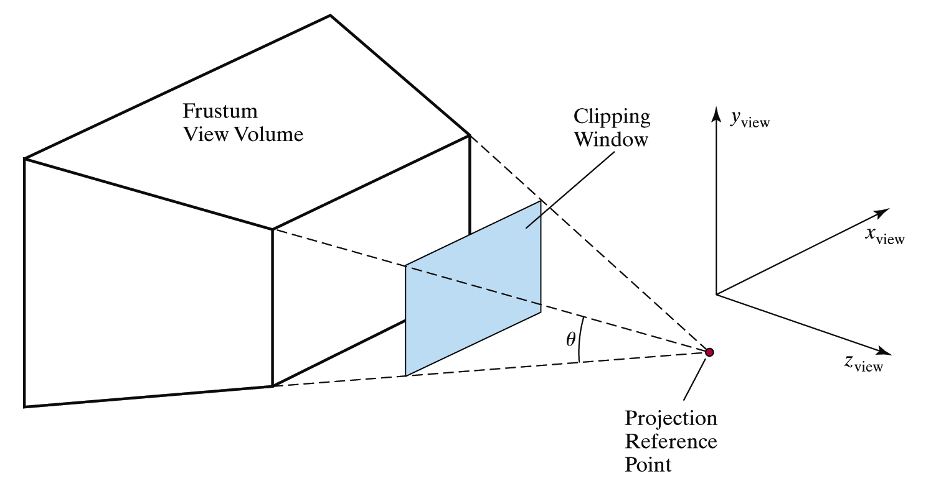
Setting Up A Perspective Projection (cont…)
The field of view angle can be a more intuitive way to specify perspective projections
This is analogous to choosing a lense for a camera
Field of view

Slide 13
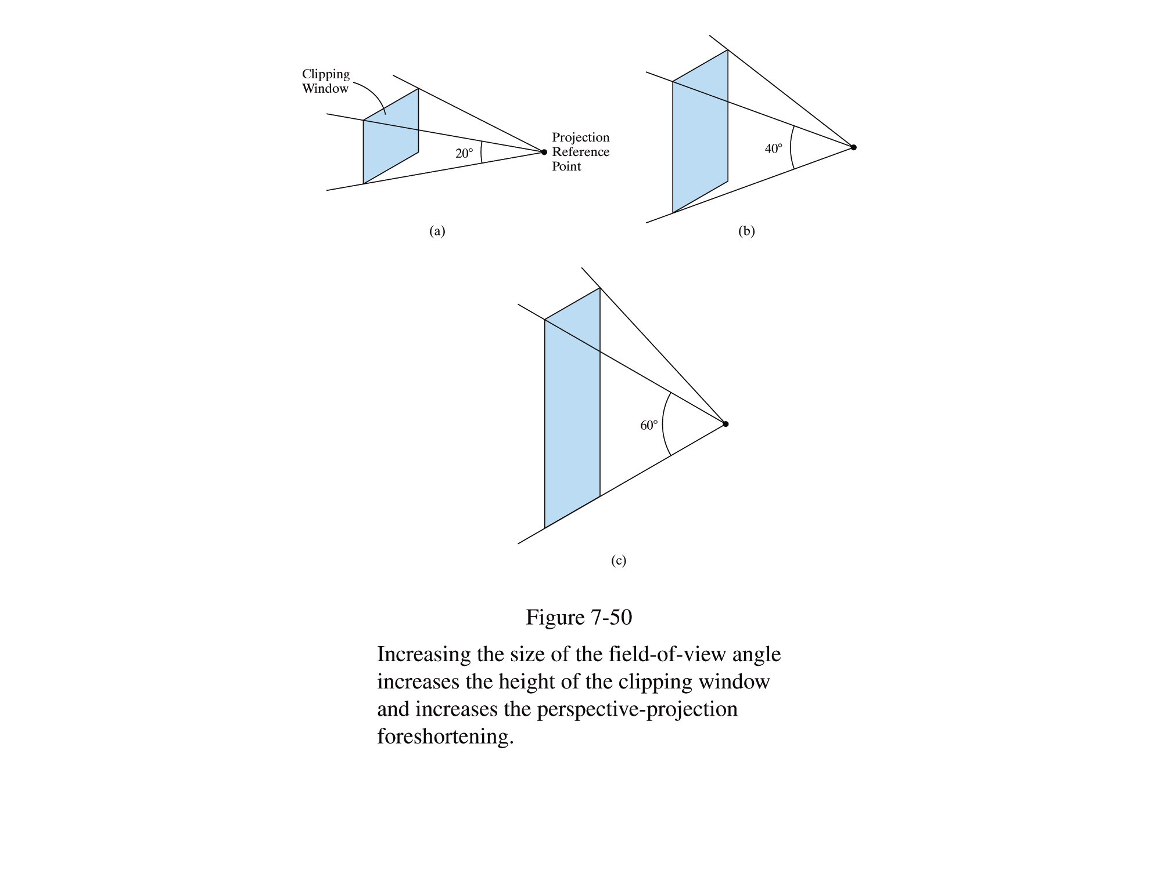
Setting Up A Perspective Projection (cont…)
Increasing the field of view angle increases the height of the view plane and so increases foreshortening

Slide 14
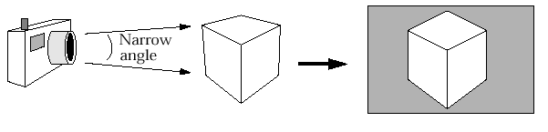
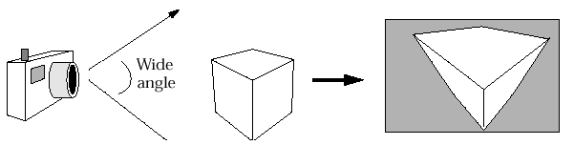
Setting Up A Perspective Projection (cont…)
The amount of foreshortening that is present can greatly affect the appearance of our scenes

Slide 15
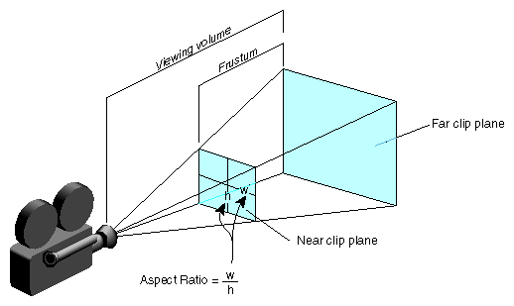
Setting Up A Perspective Projection (cont…)
We need one more thing to specify a perspective projections using the filed of view angle
The aspect ratio gives the ratio between the width sand height of the view plane
Demo

Slide 16
Summary
In today’s class we looked at the detail of generating a perspective projection of a three dimensional scene

